Slide 1
Using Apollo at the i5k Workspace@NAL
Chris Childers, USDA-ARS NAL
February 18th, 2020

Slide 2
Agenda
Manual annotation general overview
I5k Workspace tools for manual annotation
BLAST, Clustal, HMMER
Apollo2
Manual annotation example: preparation
Manual annotation live example

Slide 3
Other resources
Monica Munoz-Torres from the Apollo group has a number of comprehensive tutorials:
https://www.slideshare.net/MonicaMunozTorres/presentations
I recommend these slides if you need more background:
https://www.slideshare.net/MonicaMunozTorres/apollo-workshop-at-ksu-2015
Note - there are two versions of Apollo. Some organisms at the i5k Workspace still use the older version with a slightly different interface
If you are new to Apollo, or need a refresher, I highly recommend that you review one of her presentations
The official Apollo annotation guide:
http://genomearchitect.org/users-guide/
Other manual curation tutorials:
https://i5k.nal.usda.gov/manual-curation-example
http://genomecuration.github.io/genometrain/d-feature-curation-crossing/

Slide 4
Manual annotation general overview

Slide 5
What is manual annotation?
Manual review and improvement of an existing gene prediction
Draw on external evidence (e.g. RNA-Seq, cDNA, genes from other species) to improve a computationally predicted gene model
Functional annotation – e.g. add name
Structural annotation – e.g. modify exons

Slide 6
Why manually annotate?
“Incorrect annotations poison every experiment that makes use of them … Worse still, the poison spreads because incorrect annotations from one organism are often unknowingly used by other projects to help annotate their own genomes.”
Yandell and Ence 2012, doi:10.1038/nrg3174
Link gene models to existing literature and ontologies, providing richer data

Slide 7
General process of manual annotation
Select a chromosomal region of interest (e.g. scaffold)
E.g. find sequence of interest from one or several other species, and align against proteins or genome sequence from your species
Select appropriate evidence (tracks in Apollo, or your own files)
Determine whether a feature in your evidence provides a reasonable starting gene model
If yes: select and drag the feature to the ‘user-created annotations’ area, creating an initial gene model. If necessary use editing functions to adjust the model.
If not – get in touch with us!
Edit model if necessary
Check your edited gene model for integrity and accuracy by comparing it with available homologs
Verify that the gene model is the best representation of the underlying biology
Repeat steps 1 through 5 as needed to refine model
Add annotation details in the “Information Editor”
Name, symbol, other comments
Adapted from https://www.slideshare.net/MonicaMunozTorres/apollo-workshop-at-ksu-2015

Slide 8
Manual annotation: i5k Workspace tools

Slide 9
First, some conventions
HSP – High scoring pair in BLAST/BLAT alignments
The ‘Hits’ in an alignment result set
A subsection of a pair of sequences with sufficient score
HSPs can change based on the alignment parameters
Five prime end and three prime end
Based on direction of transcription
Initiation site is at the five prime end
Stop codon is at the three prime end
In the genome browser, arrowheads indicate direction
3’ 5’
5’ 3’

Slide 10
JBrowse and Apollo2
View: Change coloring scheme
Locate where you are on the scaffold
Search for a gene or location
Apollo2 Track selector
Revert to ‘old’ track selector
Tools: Search using BLAT
File: Add your own files
Zoom in/out
Log out
User-created annotations track
Find information about tracks
JBrowse is a web- based genome browser
Visualize features that are mapped to a genome
These features are displayed as tracks
Many different types of data may be displayed
Apollo adds editing functions to JBrowse
Manual gene curation
Changes automatically saved back to server
Edits are visible to other annotators in real-time
Editing history is tracked

Slide 11
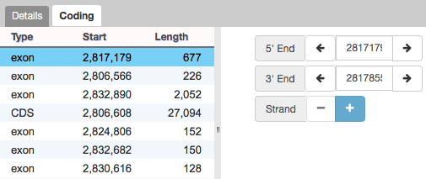
Apollo2 – Annotations Panel
Annotations panel
Filter annotations
View annotation overview
Click on arrow to jump to annotation
View functional annotation details
Can modify individual features via ‘Coding’ Panel

Slide 12
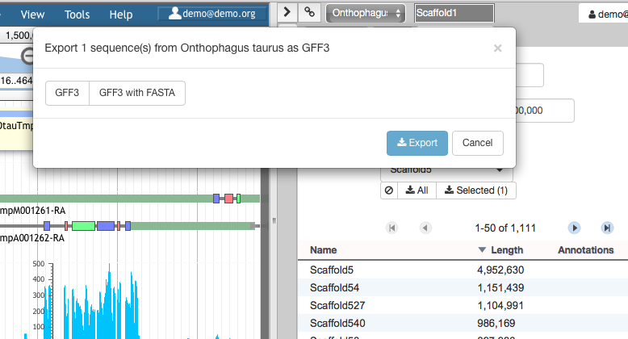
Apollo2 – Ref Sequence Panel
Reference sequence panel
Filter sequences
Export sequences/annotation gff3
View reference sequence list

Slide 13
i5k Workspace BLAST: one way to access Apollo
Select organism-specific database
Select organism
BLAST against the genome assembly to view HSPs in Jbrowse
Paste or upload query sequence(s)
Program is automatically selected
URL: https://i5k.nal.usda.gov/webapp/blast/

Slide 14
i5k Workspace BLAST: one way to access Apollo
BLAST result page with 4 panels
Click on blue blastdb icon next to your favorite HSP
Blast results are displayed in Apollo

Slide 15
HMMER and Clustal
Use HMMER to detect remote protein homologs
https://i5k.nal.usda.gov/webapp/hmmer/
Use Clustal to perform multiple sequence alignments
https://i5k.nal.usda.gov/webapp/clustal/

Slide 16
Tips and Tricks
The i5k Workspace BLAST results persist for one week
You can bookmark and share searches
BLAST HSPs are ‘draggable’ and can be used in annotations
Jbrowse/Apollo URLs can be shared
Allow you to share the exact view (including active tracks) with others
Great for troubleshooting with collaborators
In Apollo “walk” feature boundaries
Square brackets walk exon boundaries: [ and ]
Curly brackets walk gene boundaries: { and }
In Apollo, you can pin tracks to the top
If you know the name or ID of the gene that you’d like to annotate, you can paste it into the search box in Apollo to navigate to it

Slide 17
Manual annotation example: preparation

Slide 18
Annotation Example
Phosphoenolpyruvate carboxykinase (pepck) in the copepod Eurytemora affinis
Pepck catalyzes the conversion of oxaloacetate (OAA) to phosphoenolpyruvate (PEP).
More information about the copepod: https://i5k.nal.usda.gov/Eurytemora_affinis
Apollo URL (for training only): https://apollo.nal.usda.gov/apollo/3068161/jbrowse/index.html
Login credentials: demo/demo

Slide 19
Notes on E. affinis genome/browser
Big advantage for annotation: lots of RNA-Seq and transcriptome data are available to use as contributing evidence for your gene models
Includes strand-specific RNA-Seq
Disadvantage: No close reference genomes, so it may be harder to find homologs for your genes of interest to inform your annotations.

Slide 20
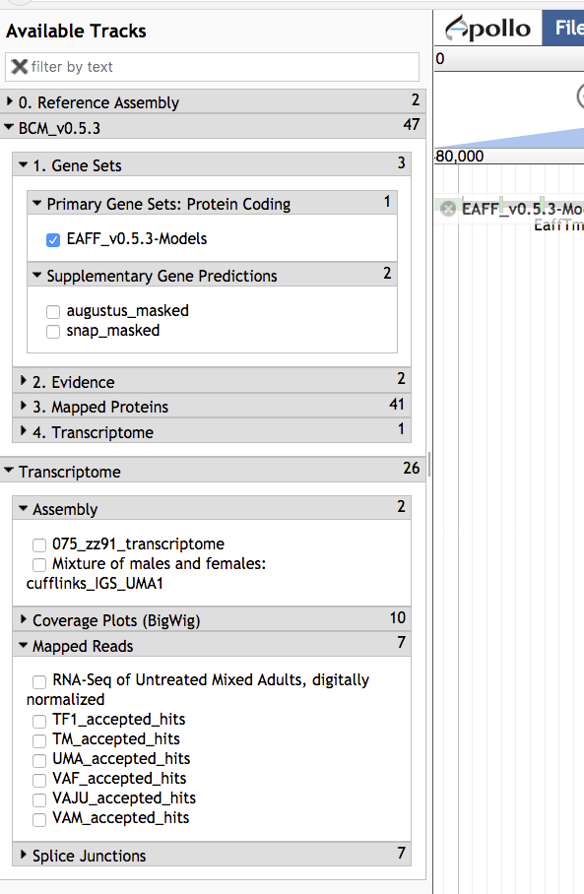
Available tracks for E. affinis
Baylor Maker annotations:
Primary Gene Set:
EAFF_v0.5.3-Models
Other tracks that were used to generate the primary gene set
Transcriptome/RNA-Seq
Transcriptome assemblies
Coverage plots, Mapped RNA-Seq data, Splice junctions
Some of the RNA-Seq libraries are stranded

Slide 21
Choosing reference proteins: D. melanogaster pepck in UniProt
Annotation score is a heuristic for annotation quality
Flybase is another great resource
Feature viewer gives graphical view of domains and sites
Catalyzes the conversion of oxaloacetate (OAA) to phosphoenolpyruvate (PEP). Source: http://www.uniprot.org/uniprot/P20007

Slide 22
Choosing reference proteins: Daphnia pulex Pepck
GenBank record: https://www.ncbi.nlm.nih.gov/protein/EFX80236.1
Treat with caution!!!

Slide 23
Manual annotation live example

Slide 24
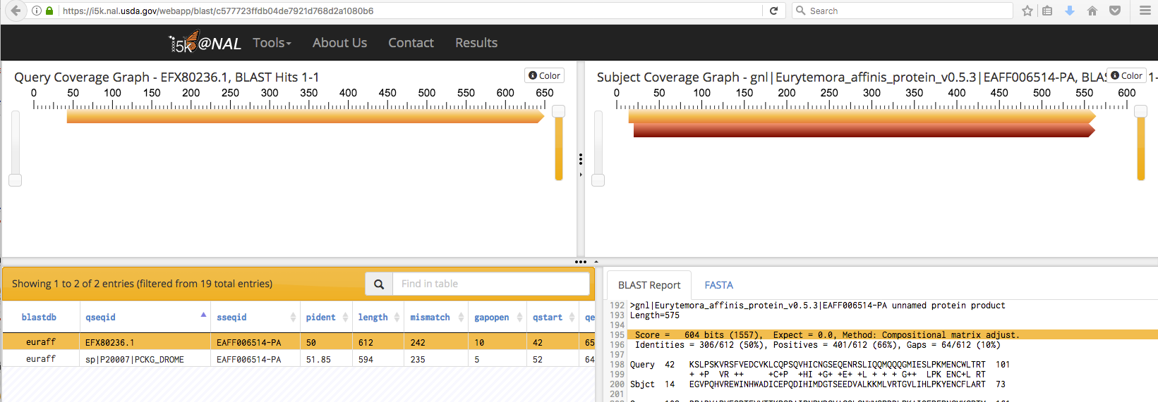
BLAST dmel, dpul proteins against E. affinis proteins https://i5k.nal.usda.gov/training/webapp/blast/
Copy the protein ‘base name’ EAFF006514 for searching in Apollo
Results are filtered by e-value; only one protein in the E. affinis dataset has a significant match

Slide 25
Modify E. affinis model sequence in Apollo
Go to Apollo URL: https://apollo.nal.usda.gov/apollo/3068161/jbrowse/index.html
Find mRNA of EAFF006514-PA in genome browser by pasting EAFF006514 into search box, selecting EAFF006514-RA
Log in to Apollo
Drag EAFF006514-RA into the yellow annotation track
Check available evidence for model

Slide 26
Another approach: BLAST against the genome
https://i5k.nal.usda.gov/training/webapp/blast/
Click on blue blastdb button next to your favorite HSP to view it in JBrowse

Slide 27
Another approach: BLAST against the genome
BLAST results are displayed as glyphs in browser; can be used as annotation starting points if the alignment is high quality

Slide 28
Create annotation in user-created annotations track
Log in with your Apollo credentials
Drag model EaffTmpM006514-RA to User-created Annotations track

Slide 29
Modify E. affinis model sequence in Apollo
Questions:
What evidence do you choose to check the integrity of the model?
Do you need additional evidence?
How do you evaluate whether the protein sequence is as complete as it can be?
Should you add/modify UTRs?

Slide 30
View available evidence
Model is on the reverse strand, so we can take advantage of the stranded RNA-Seq available for this species
RNA-Seq and transcriptome tracks suggest that one exon is missing

Slide 31
Add an exon to the model
Drag exon from transcriptome track into new gene model

Slide 32
Adjust exon boundary
CDS sequence is now UTR –zoom in to investigate
CDS frame has changed from purple to green– we need to fix this
RNA-Seq suggests we need to adjust exon boundary

Slide 33
Adjust exon boundary
Drag exon boundary to match RNA-Seq and transcriptome tracks
Fixed both reading frame and exon boundary

Slide 34
Evaluate new protein sequence
Blast modified EAFF006514-PA sequence to NCBI’s nr database
Make sure it doesn’t match a potential contaminant
Get an idea whether you have the right sequence
Blastp home:
https://blast.ncbi.nlm.nih.gov/Blast.cgi?PROGRAM=blastp&PAGE_TYPE=BlastSearch&LINK_LOC=blasthome
Once contamination is ruled out, it’s better to align your sequence against a smaller set of high-quality proteins
If you notice that parts of the protein are missing, check the ‘Gaps in assembly’ track in the browser

Slide 35
Evaluate new protein sequence
Get E. affinis pepck protein sequence from old model and new model
Align new and old sequence to dmel and dmag protein sequences
Clustal (https://i5k.nal.usda.gov/webapp/clustal/)
Can also use NCBI Blast
Check alignment extent, %ID

Slide 36
Clustal Results
New exon added
Another exon might be missing (we’re not going to handle this today)

Slide 37
Using the Information Editor
Use the mRNA/transcript side of the IE
Review our naming guidelines before naming: https://i5k.nal.usda.gov/i5k-workspace-gene-and-protein-naming-guidelines

Slide 38
Using the Information Editor
Select the model in Apollo, then right-click, and select ‘Edit Information’ from the drop-down menu
Use the ‘mRNA’ section
Name: We recommend the INSDC naming guidelines:
http://www.uniprot.org/docs/nameprot
If a naming convention exists, use it (e.g. for gene families)
Name should be unique and attributed to all orthologs (as far as possible)
Use name from an orthologous protein if you are sure that your gene model is an ortholog.
Document your justification for the name in the Comments field (e.g. “88% sequence similarity via blastp to D. melanogaster pepck P20007”)
Comments – Document what changes you performed, and your justification for the name. These notes will be visible in the OGS, so make sure that others understand them

Slide 39
Checklist for accuracy and integrity
Check start, stop and exon boundaries (splice sites)
Try to fix non-canonical splice sites if possible
Check if you can annotate UTRs (e.g. using RNA-Seq data)
Check for gaps in the genome
If you change the genome sequence, add a justification comment to the corresponding gene model
Use BLAST or a multiple sequence aligner
To look at completeness of model
To verify the appropriateness of the gene name
In the Information editor mRNA field
Update the Name if appropriate
Add comments that describe
your evidence for the annotation
Modifications that you made to the gene model
cf. https://www.slideshare.net/MonicaMunozTorres/editing-functionality-apollo-workshop

Slide 40
What happens to my annotation when I’m done?
This depends on the genome project that you’re working on.
If the genome coordinator has asked us to generate an OGS (Official Gene Set), we will do so
We are still working on this process, so if you ask us to do this, 1) it will take some time, and 2) we will probably ask you for co-authorship if you publish a paper on the OGS.
We are working on a pipeline to submit Official Gene Sets to GenBank, where they will be archived/accessioned
Otherwise, don’t assume that your annotation will be archived.
If you need it to be, get in touch with us and we’ll figure out what to do.
Get in touch with us and the genome project coordinator if you’re not sure about the status of a genome project.
https://i5k.nal.usda.gov/data-management-policy

Slide 41
I5k Workspace ‘Etiquette’
Use Apollo to improve a gene model in an i5k Workspace assembly.
If you just want to practice – use one of our training instances.
https://i5k.nal.usda.gov/jbrowseapollo-training
If you just want to view the data – you probably can get what you want without using Apollo. All of the data that we host is public.
Your annotation work is a community effort.
If you notice that someone else is working on your model of choice, get in touch with them (or us) and collaborate – don’t make a 2nd model or delete the other model.
Keep in mind that your work may be used by the scientific community once you’re done.
If you publish any of your work generated in the i5k workspace:
Get in touch with the genome contact first (you can find the contact info on the organism page; https://i5k.nal.usda.gov/species);
Please cite the i5k Workspace paper! This helps us continue to exist.
https://doi.org/10.1093/nar/gku983

Slide 42
Thank you!
The NAL Team
Monica Poelchau
Chris Childers
Gary Moore
Susan McCarthy
Shang-Yu Chiang
Hsiu-Kang Huang
I5k Workspace alumni
Yu-yu Lin
Chaitanya Gutta
Li-Mei Chiang
Yi Hsiao
Chien-Yueh Lee
Han Lin
Jun-Wei Lin
Vijaya Tsavatapalli
Mei-Ju Chen
Chao-I Tuan
Min-Chen Hsu
Chun-Hung Lin
Chia-Tung Wu
i5k Coordinating Committee
i5k Pilot Project
Apollo & JBrowse Development Teams
GMOD/Tripal community
All of our users and contributors!
Contact us:
https://i5k.nal.usda.gov/contact
i5k@ars.usda.gov
Monica.Poelchau@usda.gov
Christopher.Childers@usda.gov

